Slide 1
Reminder: elementary probability
Basic laws: 0 ≤ P(ω) ≤ 1 ∑_{ω ∈Ω} P(ω) = 1
Events: subsets of Ω: P(A) = ∑_{ω ∈ A} P(ω)
Random variable X(ω) has a value in each ω
Distribution P(X) gives probability for each possible value x
Joint distribution P(X,Y) gives total probability for each combination x,y
Summing out/marginalization: P(X=x) = ∑_{y} P(X=x,Y=y)
Conditional probability: P(X|Y) = P(X,Y)/P(Y)
Product rule: P(X|Y)P(Y) = P(X,Y) = P(Y|X)P(X)
Generalize to chain rule: P(X₁,..,X_{n}) = ∏_{i} P(X_{i} | X₁,..,X_{i-1})

Slide 2
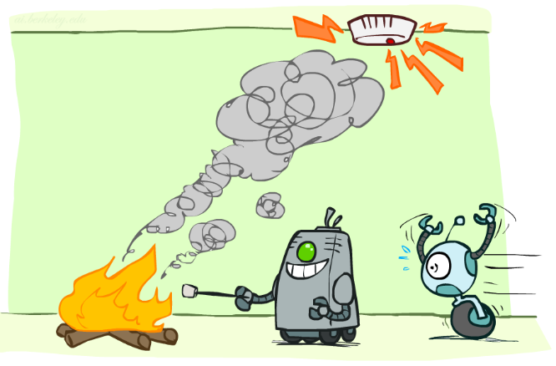
Conditional Independence

Slide 3
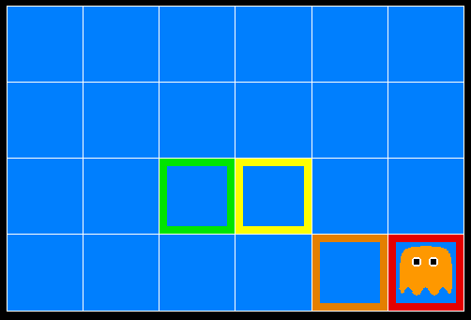
Ghostbusters
A ghost is in the grid somewhere
Sensor readings tell how close a square is to the ghost
On the ghost: usually red
1 or 2 away: mostly orange
3 or 4 away: typically yellow
5+ away: often green
Click on squares until confident of location, then “bust”

Slide 4

Video of Demo Ghostbusters with Probability

Slide 5
Ghostbusters model
0.11
0.11
0.11
Variables and ranges:
G (ghost location) in {(1,1),…,(3,3)}
C_{x,y} (color measured at square x,y) in {red,orange,yellow,green}
Ghostbuster physics:
Uniform prior distribution over ghost location: P(G)
Sensor model: P(C_{x,y} | G) (depends only on distance to G)
E.g. P(C_{1,1} = yellow | G = (1,1) ) = 0.1
0.11
0.11
0.11
0.11
0.11
0.11

Slide 6

Ghostbusters model, contd.
0.11
0.11
0.11
P(G, C_{1,1} , … C_{3,3}) has 9 x 4⁹ = 2,359,296 entries!!!
Ghostbuster independence:
Are C_{1,1} and C_{1,2} independent?
E.g., does P(C_{1,1} = yellow) = P(C_{1,1} = yellow | C_{1,2} = orange) ?
Ghostbuster physics again:
P(C_{x,y} | G) depends only on distance to G
So P(C_{1,1} = yellow | G = (2,3) ) = P(C_{1,1} = yellow | G = (2,3), C_{1,2} = orange)
I.e., C_{1,1} is conditionally independent of C_{1,2} given G
0.11
0.11
0.11
0.11
0.11
0.11

Slide 7
Ghostbusters model, contd.
Apply the chain rule to decompose the joint probability model:
P(G, C_{1,1} , … C_{3,3}) = P(G) P(C_{1,1} | G) P(C_{1,2} | G, C_{1,1}) P(C_{1,3} | G, C_{1,1}, C_{1,2}) … P(C_{3,3} | G, C_{1,1}, …, C_{3,2})
Now simplify using conditional independence:
P(G, C_{1,1} , … C_{3,3}) = P(G) P(C_{1,1} | G) P(C_{1,2} | G) P(C_{1,3} | G) … P(C_{3,3} | G)
I.e., conditional independence properties of ghostbuster physics simplify the probability model from exponential to quadratic in the number of squares
This is called a Naïve Bayes model:
One discrete query variable (often called the class or category variable)
All other variables are (potentially) evidence variables
Evidence variables are all conditionally independent given the query variable
G
C_{1,1}
C_{1,2}
C_{3,3}

Slide 8
Conditional Independence
Conditional independence is our most basic and robust form of knowledge about uncertain environments.
X is conditionally independent of Y given Z if and only if:
∀x,y,z P(x | y, z) = P(x | z)
or, equivalently, if and only if
∀x,y,z P(x, y | z) = P(x | z) P(y | z)

Slide 9
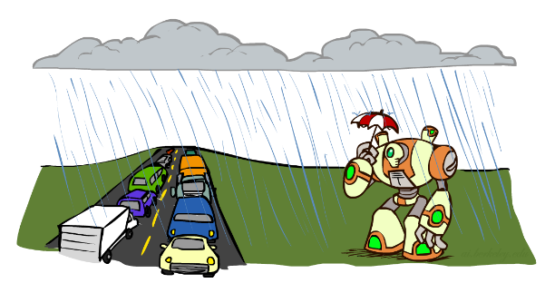
Conditional Independence
What about this domain:
Traffic
Umbrella
Raining

Slide 10

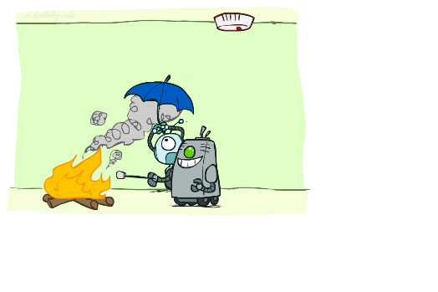
Conditional Independence
What about this domain:
Fire
Smoke
Alarm

Slide 11
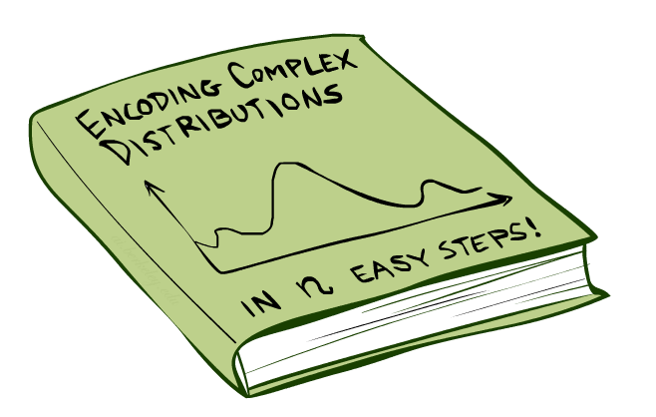
Bayes Nets: Big Picture

Slide 12

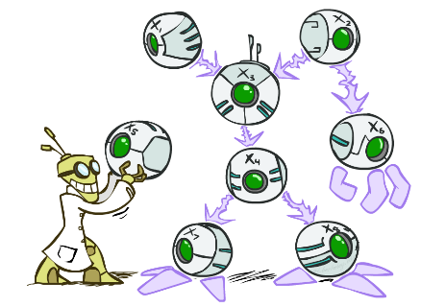
Bayes Nets: Big Picture
Bayes nets: a technique for describing complex joint distributions (models) using simple, conditional distributions
A subset of the general class of graphical models
Use local causality/conditional independence:
the world is composed of many variables,
each interacting locally with a few others
Outline
Representation
Exact inference
Approximate inference

Slide 13
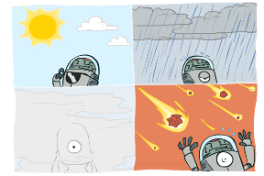
Graphical Model Notation
Nodes: variables (with domains)
Can be assigned (observed) or unassigned (unobserved)
Arcs: interactions
Indicate “direct influence” between variables
Formally: absence of arc encodes conditional independence (more later)
Weather
G
0.11
0.11
0.11
C_{1,1}
C_{1,2}
C_{3,3}
0.11
0.11
0.11
0.11
0.11
0.11

Slide 14

Example: Coin Flips
n independent coin flips
No interactions between variables: absolute independence
X₁
X₂
X_{n}

Slide 15
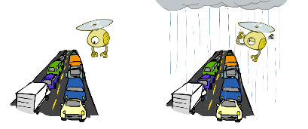
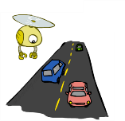
Example: Traffic
Variables:
T: There is traffic
U: I’m holding my umbrella
R: It rains
R
T
U

Slide 16
Example: Smoke alarm
Variables:
F: There is fire
S: There is smoke
A: Alarm sounds
F
S
A

Slide 17
Example Bayes’ Net: Car Insurance

Slide 18
Example Bayes’ Net: Car Won’t Start

Slide 19
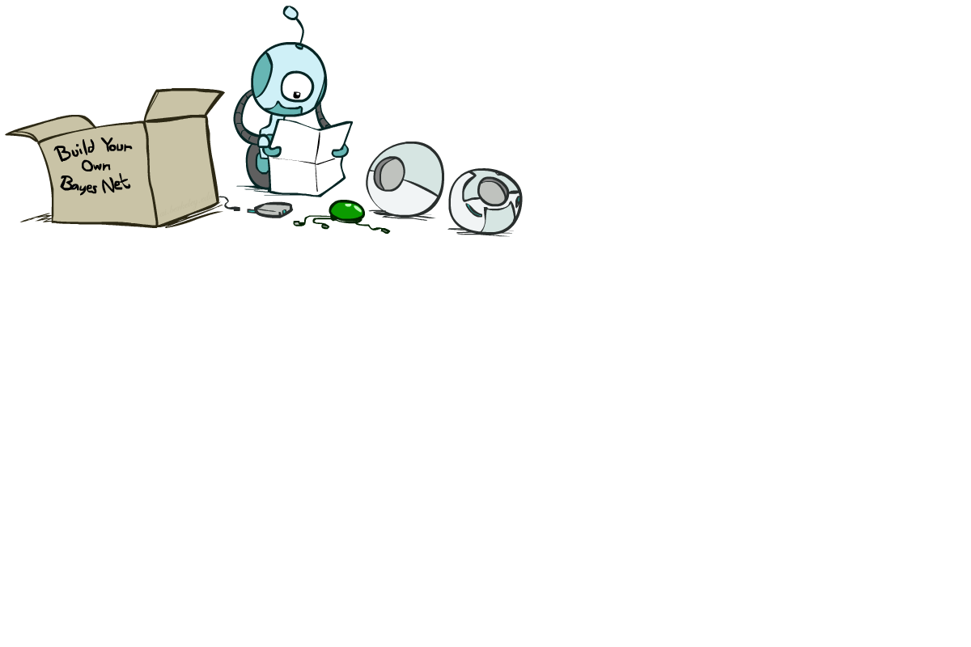
Bayes Net Syntax and Semantics

Slide 20
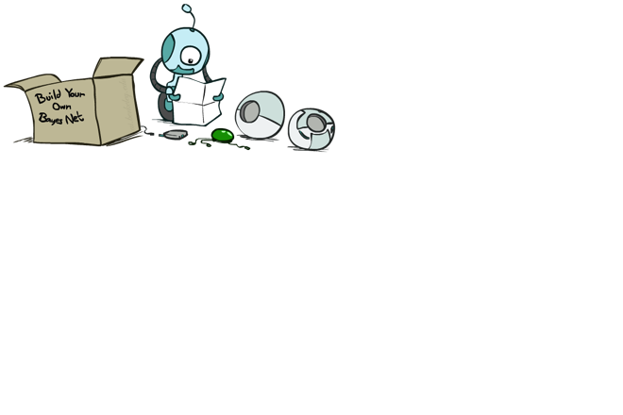
Bayes Net Syntax
A set of nodes, one per variable X_{i}
A directed, acyclic graph
A conditional distribution for each node given its parent variables in the graph
CPT (conditional probability table); each row is a distribution for child given values of its parents
P(G)
(1,1) | (1,2) | (1,3) | …
0.11 | 0.11 | 0.11 | …
G
C_{1,1}
C_{1,2}
C_{3,3}
G | P(C_{1,1} | G)
 | g | y | o | r
(1,1) | 0.01 | 0.1 | 0.3 | 0.59
(1,2) | 0.1 | 0.3 | 0.5 | 0.1
(1,3) | 0.3 | 0.5 | 0.19 | 0.01
…
Bayes net = Topology (graph) + Local Conditional Probabilities

Slide 21
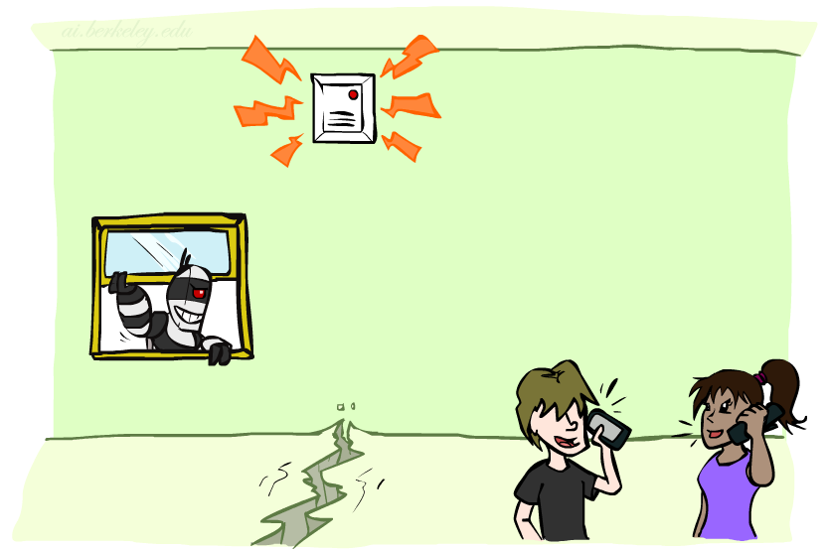
Example: Alarm Network
1
1
P(E)
true | false
0.002 | 0.998
P(B)
true | false
0.001 | 0.999
Burglary
Earthquake
B | E | P(A|B,E)
 |  | true | false
true | true | 0.95 | 0.05
true | false | 0.94 | 0.06
false | true | 0.29 | 0.71
false | false | 0.001 | 0.999
Alarm
4
Number of free parameters in each CPT:
Parent range sizes d₁,…,d_{k}
Child range size d
Each table row must sum to 1
(d-1) Π_{i} d_{i}
John calls
Mary calls
A | P(J|A)
 | true | false
true | 0.9 | 0.1
false | 0.05 | 0.95
A | P(M|A)
 | true | false
true | 0.7 | 0.3
false | 0.01 | 0.99
2
2
Notes:
demo

Slide 22
General formula for sparse BNs
Suppose
n variables
Maximum range size is d
Maximum number of parents is k
Full joint distribution has size O(d^{n})
Bayes net has size O(n .d^{k})
Linear scaling with n as long as causal structure is local

Slide 23
Bayes net global semantics
Bayes nets encode joint distributions as product of conditional distributions on each variable:
P(X₁,..,X_{n}) = ∏_{i} P(X_{i} | Parents(X_{i}))

Slide 24
Example
P(E)
true | false
0.002 | 0.998
P(b,¬e, a, ¬j, ¬m) =
P(B)
true | false
0.001 | 0.999
Burglary
Earthquake
P(b)
P(¬e)
P(a|b,¬e)
P(¬j|a)
P(¬m|a)
=.001x.998x.94x.1x.3=.000028
B | E | P(A|B,E)
 |  | true | false
true | true | 0.95 | 0.05
true | false | 0.94 | 0.06
false | true | 0.29 | 0.71
false | false | 0.001 | 0.999
Alarm
John calls
Mary calls
A | P(J|A)
 | true | false
true | 0.9 | 0.1
false | 0.05 | 0.95
A | P(M|A)
 | true | false
true | 0.7 | 0.3
false | 0.01 | 0.99

Slide 25
Conditional independence in BNs
Compare the Bayes net global semantics
P(X₁,..,X_{n}) = ∏_{i} P(X_{i} | Parents(X_{i}))
with the chain rule identity
P(X₁,..,X_{n}) = ∏_{i} P(X_{i} | X₁,…,X_{i-1})
Assume (without loss of generality) that X₁,..,X_{n} sorted in topological order according to the graph (i.e., parents before children), so Parents(X_{i}) ⊆ X₁,…,X_{i-1}
So the Bayes net asserts conditional independences P(X_{i} | X₁,…,X_{i-1}) = P(X_{i} | Parents(X_{i}))
To ensure these are valid, choose parents for node X_{i} that “shield” it from other predecessors

Slide 26
Conditional independence semantics
Every variable is conditionally independent of its non-descendants given its parents
Conditional independence semantics <=> global semantics

Slide 27
Example: Burglary
P(B)
true | false
0.001 | 0.999
P(E)
true | false
0.002 | 0.998
Burglary
Earthquake
Alarm
Burglary
?
Earthquake
?
?
Alarm
B | E | P(A|B,E)
 |  | true | false
true | true | 0.95 | 0.05
true | false | 0.94 | 0.06
false | true | 0.29 | 0.71
false | false | 0.001 | 0.999

Slide 28
Example: Burglary
P(A)
true | false
Alarm
Burglary
Earthquake
Alarm
?
?
A | B | P(E|A,B)
 |  | true | false
true | true
true | false
false | true
false | false
A | P(B|A)
 | true | false
true
false
Burglary
Earthquake
?
?
?

Slide 29

Inference by Enumeration in Bayes Net
Reminder of inference by enumeration:
Any probability of interest can be computed by summing entries from the joint distribution: P(Q | e) = α ∑_{h} P(Q , h, e)
Entries from the joint distribution can be obtained from a BN by multiplying the corresponding conditional probabilities
P(B | j, m) = α ∑_{e,a} P(B, e, a, j, m)
= α ∑_{e,a} P(B) P(e) P(a|B,e) P(j|a) P(m|a)
So inference in Bayes nets means computing sums of products of numbers: sounds easy!!
Problem: sums of exponentially many products!
B
E
A
J
M

Slide 30
Can we do better?
Consider uwy + uwz + uxy + uxz + vwy + vwz + vxy +vxz
16 multiplies, 7 adds
Lots of repeated subexpressions!
Rewrite as (u+v)(w+x)(y+z)
2 multiplies, 3 adds
∑_{e,a} P(B) P(e) P(a|B,e) P(j|a) P(m|a)
= P(B)P(e)P(a|B,e)P(j|a)P(m|a) + P(B)P(¬e)P(a|B,¬e)P(j|a)P(m|a)
+ P(B)P(e)P(¬a|B,e)P(j|¬a)P(m|¬a) + P(B)P(¬e)P(¬a|B,¬e)P(j|¬a)P(m|¬a)
Lots of repeated subexpressions!

Slide 31

Summary
Independence and conditional independence are important forms of probabilistic knowledge
Bayes net encode joint distributions efficiently by taking advantage of conditional independence
Global joint probability = product of local conditionals
Exact inference = sums of products of conditional probabilities from the network

